Slide 1
The Perils of Bad Behavior: Why Misconduct Taints Us All
An International Perspective from the ICRS

Slide 2
Dr Lisa Richard, Chair
Ms Donna Cohen, Executive Director

Slide 3
Learning objectives
To understand the role of rules in regulation (as well as in associations for nations without legislation);
To identify, analyze, and apply rules-based concepts to actual practice scenarios
To develop safeguards for chiropractic practice

Slide 4
What types of laws are there?
Three types of law:
Criminal
Civil
Administrative
Act / Legislation
More detailed rules (sometimes called regulations)
Similar dues process requirements for other government agencies

Slide 5
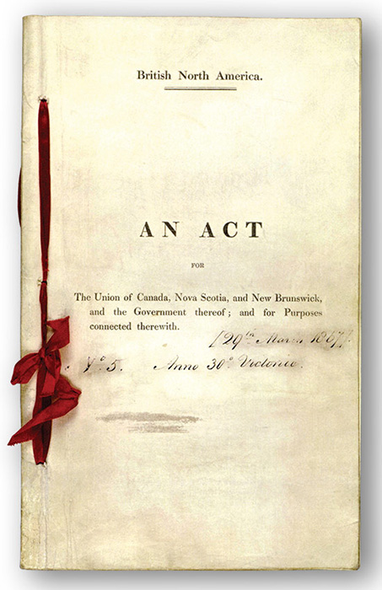
Why have legislation?
PROTECT THE PUBLIC
What other benefits do you think legislation provides?

Slide 6
Why legislation?
Practice Act (Legislation) – Administrative Law
Provides title protection & defines practice
Creates a body to enforce the law and set up regulations
Establishes requirements to practice
Determines when and how practice privilege should be revoked
Generally has a lower burden of proof than other two types of law

Slide 7
Where are the details?
MORE AUTHORITY
MORE DETAILED GUIDANCE

Slide 8
What is ICRS?
International non-profit
Based out of Canada
Totally volunteer powered
Membership for organizations, not individuals

Slide 9
What is ICRS?
Mission:
Best practices in international chiropractic regulation ​to protect the public interest

Slide 10
Why ICRS?
PROTECT THE PUBLIC
Support those countries with chiropractic legislation
Serve as resource for countries seeking regulation

Slide 11
Why ICRS?
Showcase best practices in chiropractic regulation
Encourage greater uniformity in laws while respecting cultural differences

Slide 12
Why greater uniformity?
Ease process of relocation for qualified practitioners
Encourage equivalence in education
Support fair, due process for disciplinary matters
Make sure regulations do not stifle development of the profession
Facilitate exchange of information regarding disciplined doctors so other jurisdictions can make informed decisions

Slide 13
Regulation in the News

Slide 14
Regulation in the News
Overview of international regulatory issues revealed through public news articles
How does the profession appear in the media?
What are current news stories in your country?

Slide 15
Why Good Rules Matter
What could have been done to avoid current cases in the news?
What proactive steps can we take to help increase doctors’ awareness of possible problems?
Why do carefully worded regulations help?
How much authority do associations have?

Slide 16
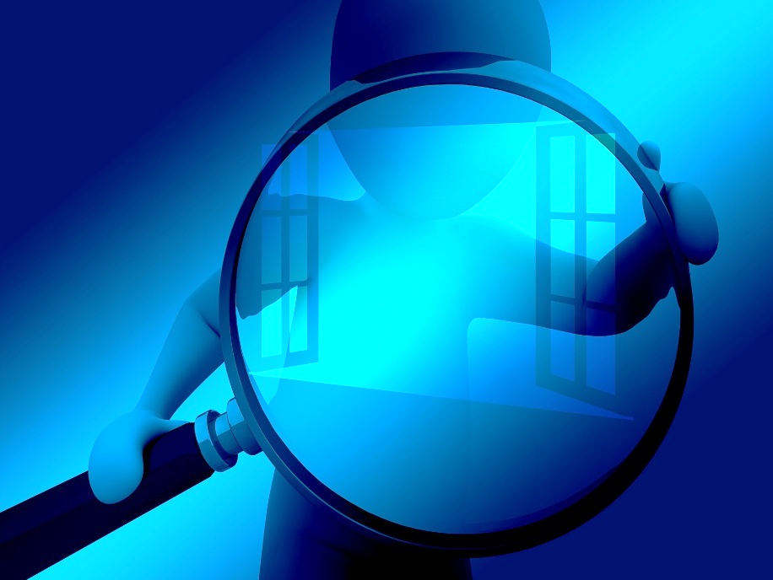
Learning from Experience
Let’s take an in-depth look at some actual disciplinary cases
Can you identify the violations?
Refer to handout

Slide 17
Discussion
At which point should information be public?
How is public information distributed?
Does it help or hurt the profession when these cases come up?
How do we ensure due process for all parties?
Can other doctors learn from these cases once they are public?
Do regulations need to change? How?

Slide 18
We Are Not Alone: International Community
We cannot improve in isolation
We must work together
We can always do better!
We must not fear honest introspection and evaluation

Slide 19
We Are Not Alone: International Community
Learn the vocabulary and principles behind public protection
Accreditation
Examination
Discipline
Every person, every country has something they do exceptionally well
The only acceptable theft is stealing good ideas!

Slide 20
Types of Resources:
Laws / regulations
Codes of conduct
Practitioner guidelines
Standards for accreditation and examination
People

Slide 21
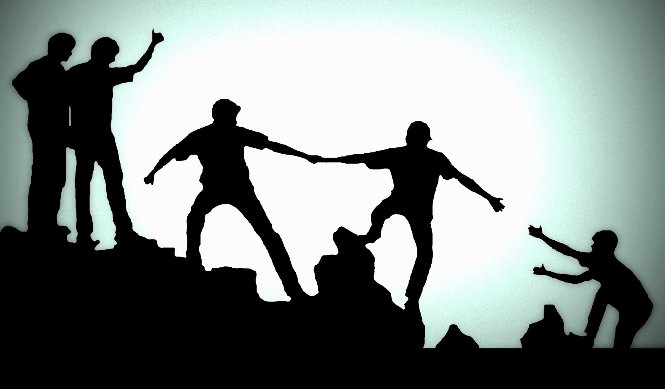
Take home applications
How will you apply what you learned here and at other EPIC2019 workshops?
Do you need help? With what?
What help can you offer others who have regulatory issues?

Slide 22
Summary / Evaluation
ICRS is happy to coordinate needs and resources, working closely with other organizations
If we don’t know, we’ll try to send you to someone who does
Was this workshop helpful? How can we improve it?
Would you like to help with any ICRS projects?

