Slide 1
AGENDA
Welcome – Dr Wayne Minter, ICRS Chair
ICRS Overview
Program: It’s All About the Data – Donna M Cohen, ICRS Executive Director
Organizations Registered to Report
Regulatory Members: Canada, New Zealand, UK, Australia
CCE-International – Dr Cynthia Peterson
All Other Updates

Slide 2
Bottom of ZOOM screen
Please mute your microphone if you are not speaking
TIP: If the screen is lagging, disable your own camera for a while.
We just can’t see you but you can still see the slides.

Slide 3
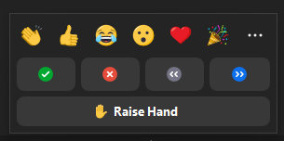
Bottom of ZOOM screen
OK to REACT
USE CHAT
Please do NOT raise hand

Slide 4
©2021 ICRS

Slide 5
It’s all about the data
No more document management
©2021 ICRS

Slide 6
Organizations are measured
TRANSPARENCY
EFFECTIVENESS
©2021 ICRS

Slide 7
Primary stakeholders
Government
Registrants
Students / examinees
Staff / team members
Accredited programs
Public
Secondary stakeholders
Peers
Yelp / social networks
©2021 ICRS

Slide 8
Perceptions
Not everything is easy to quantify
Measurable
Trustworthy
Helpful
Fair
Expertise
Info available
How many
How long
Compare
©2021 ICRS

Slide 9
Measurable
Timeliness
Issuing / renewing registrations / licenses
Investigating and prosecuting fitness to practice complaints
Measuring effectiveness / consistency of sanctions
Providing guidance to registrants
Inclusion
Composition of governance
Active outreach efforts
Consultations – before adopting new policies
Cost Effectiveness
Using your resources well
Comparisons – against previous years, other professions, peers
©2021 ICRS
Notes:
NBCE 2020 Practice Analysis – Validity of exam content, also snapshot of the profession

Slide 10
Perceptions
Trustworthiness
“We had 4,348 instances last year of acting in the public interest”
Reports should still address non-measurable issues
Can still be surveyed – GCC, CBA
How is your organization perceived
Primary and secondary stakeholders
List improvements to services and resources
Remind that data and transactions are secure
©2021 ICRS
Notes:
GCC: Registrant Survey 2020 - to explore registrants views including qualifications, job satisfaction, clinical practice and the future of the profession. 968 registrants completed survey.
Public perceptions research 2020 - national survey of over 1,000 members of UK public: public perceptions / awareness of chiropractic services. Also 243 chiropractic patients who have visited a chiropractor for treatment
Chiropractic Board of Australia - 2019: Practitioner and community perceptions of (Ahpra) and the National Boards:

Slide 11
Understanding Data
Metrics
The actual data fields
Useful info?
Key Performance Indicators / Measures (KPI/KPM)
Strategically defined to support objectives
Analytics
interpretations of data
transforms numbers / metrics into actionable ideas & insights
©2021 ICRS

Slide 12
©2021 ICRS

Slide 13
Increasing use of
INFOGRAPHICS
©2021 ICRS

Slide 14
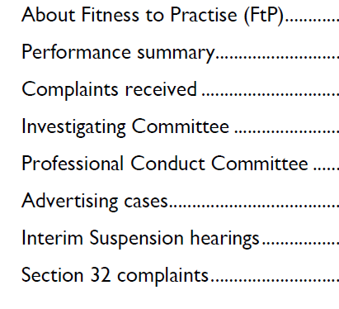
Exemplary graphics & analytics
©2021 ICRS

Slide 15
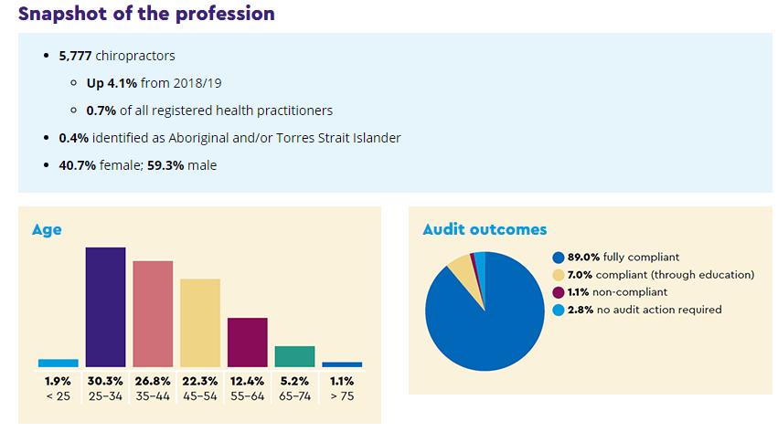
Easy to understand
metrics
©2021 ICRS

Slide 16
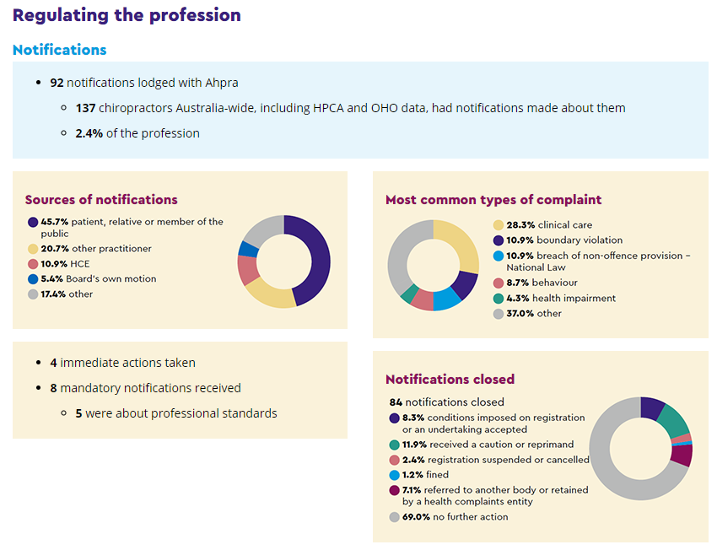
©2021 ICRS

Slide 17
Chiropractic Examiners, Board of
Annual Performance Progress Report
Reporting Year 2020
Published: 10/1/2020 1:18:47 PM
©2021 ICRS

Slide 18
Approved Key Performance Measures (KPMs)
1 | Average number of days to resolve a complaint
2 | Percent of sexual misconduct/boundary complaints resolved in 180 days
3 | Percentage of new complaints assessed, investigated, presented to board within 120 days
4 | Percentage of chiropractic physicians meeting annual continuing education requirements
5 | Percentage of licenses issued within 5 days once all application components (that are responsibility of applicant) have been received
6 | Customer Service - Percent of customers rating their satisfaction with the agency's customer service as "good" or "excellent": overall customer service, timeliness, accuracy, helpfulness, expertise, and availability of information
7 | Board Best Practices - Percent of total best practices met by Board.
8 | Days between complaint receipt and investigation preparation for Board. Percent of cases having investigative reports written within 120 days from when complaint is received to when investigation prepared for Board review/action
9 | Days between investigation preparation and presentation to Board. Percent of cases, with prepared investigation ready for Board review/action, presented to the Board within 30 days of completion
10 | Days between Board review/initial action and case closure. Percent of cases closed within 90 days of Board review/initial action.
©2021 ICRS

Slide 19
Your data
What metrics are you collecting?
What are you missing?
Have you identified a KPI / Analytic reason for each field?
Example of a new data field:
FCLB asked US boards to collect US federal National Practitioner Identifier
Why? Social identification numbers have legal privacy restrictions
Feedback Loop
©2021 ICRS

Slide 20
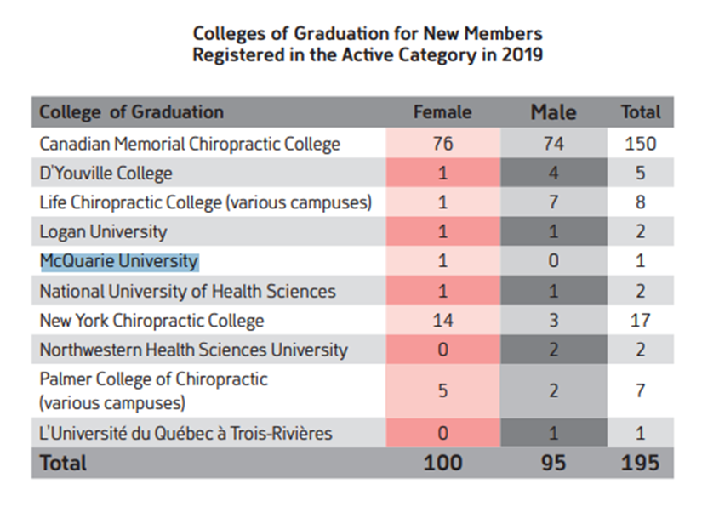
Capturing data consistently – Grad Example
Macquarie University – Dept of Chiropractic
1
3
Palmer
Palmer Davenport
Palmer Iowa / Florida / California
Palmer Chiropractic College
Palmer College
PCC
Palmer CC
Palmer University – Chiropractic Program
2
©2021 ICRS

Slide 21
Are your data fields set up for these?
DEGREE | FULL NAME
D.C. and M.S. (Chiro) | Doctor of Chiropractic & Master of Science (Chiropractic)
B.App.Sc. (clin). & B.C.Sc. | Bachelor of Applied Science (Clinical Science) & Bachelor of Chiropractic Science
B.Sc. (chiro) & B.C. | Bachelor of Science (Chiropractic) & Bachelor of Chiropractic
B.App.Sc. (Compl) & M.Clin.Chiro. | Bachelor of Applied Science (Complementary Medicine) & Master of Clinical Chiropractic
B.Chiro. | Bachelor of Chiropractic
B.Chiro. & M.Chiro | Bachelor of Chiropractic & Master of Chiropractic
B.Sc. (Hons) Chiro | Bachelor of Science (Hons) Chiropractic
B.Tech. (chiro) and M.Tech. (chiro) | Bachelor in Technology (Chiropractic) & Master in Technology (Chiropractic)
D.C. | Doctor of Chiropractic
M.C. or M.Chiro. | Master of Chiropractic or Master in Chiropractic
M.C.B. | Master in Clinical Biomechanics
M.Sc.(Chiro) or M.Chiro | Master of Science (Chiropractic)
©2021 ICRS

Slide 22
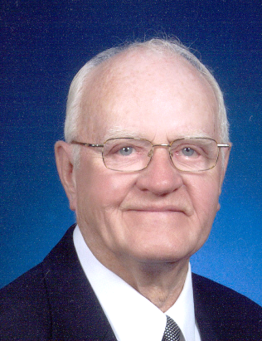
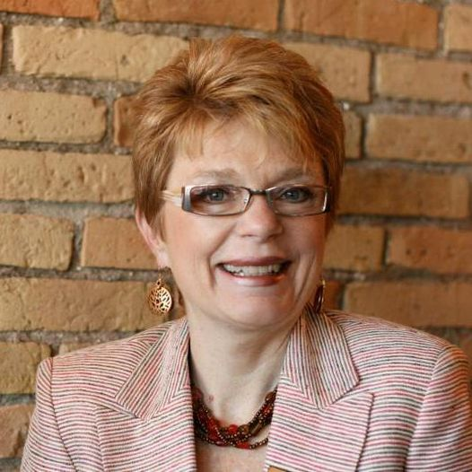
Some Common Metrics Issues
Public or Private?
Name: Surname or Family Name; Hyphens; Changes
Generations – Jr, Sr, II, III
Dr. Carol Winkler
Dr. Carroll Winkler
©2021 ICRS

Slide 23
More Common Metrics Issues
Address formats
Practice vs mailing? Both?
Multiple jurisdictions / countries
Date formats – YYYY MM DD
Gender – M / F / Trans / Non-Binary / Two-Spirit – 52 genders
National social identifier
Country name: EXAMPLE Deutschland, Allemagne, Germany
©2021 ICRS

Slide 24
It’s a battle
FLEXIBILITY and INCLUSION
STANDARDIZATION
(Sorting and analytics)
©2021 ICRS

Slide 25
Lee
Giselle
DeAndrade
De Andrade
de Andrade
Can you search by
Ask your IT team
©2021 ICRS

Slide 26
More on names
Saint German
SaintGermain
Saint-Germain
St. Germain
St.Germain
StGermain
St Germain
St-Germain
O’Connor
OConnor
Oconnor
O Connor
LaTonya
LaToya
Al-Hassan
AlHassan
al-Hassan
alHassan
al Hassan
Courtesy of Chiropractic Economics
©2021 ICRS
Notes:
Rasha-Abual-Ragheb (aka Rasha Abu)
Stephanie Hazelton (aka Ayla Wolf)

Slide 27
When It Goes Wrong
Doctor’s Medical License Terminated After Another Doctor Of The Same Name Bounces Check
CHICAGO (CBS) – 4/9/2021 Two doctors with the same name are now part of a medical mixup that is causing a nightmare for one of them.
https://chicago.cbslocal.com/2021/04/08/doctors-same-name-illinois-medical-license-terminated/
©2021 ICRS

Slide 28
Case of Brian Yu, MD
Lives in eastern Texas but used to work in Illinois
Maintained medical license in Illinois
March 19 he learned it was “terminated due to insufficient funds”
Would be black mark on medical license history
Another Dr. Brian Yu works at a practice in Chicago
His $23 debt was assigned to medical license of Dr. Brian Yu of Texas
Despite many phone calls he was told to just “pay the bill.”
©2021 ICRS

Slide 29
What do you want to know?
How does it help your organization to know it?
In general, allow for longer data fields
Drop down data entry boxes where practical
United Nations - International Telecommunication Union E.164 = 15
Country code (1 to 3 digits)
Subscriber number (max 12 digits)
TIPS
©2021 ICRS
Notes:
40 Different personal name formats; 240 countries; 130+ different address formats; 6,000 languages

Slide 30
A Case Study: Oscar Alberto Cornelio-Flores
No guilt or innocence is assumed – case from public records
September 2020: North Carolina
Invited patient to private home to “discuss her recent test results”
November 2020
Arrested and charged with sexual assault – media coverage
Employer placed on him on leave
1 January 2021
Employer officially terminated him
Later in January: Insurance company recommended him to elderly woman
©2021 ICRS

Slide 31
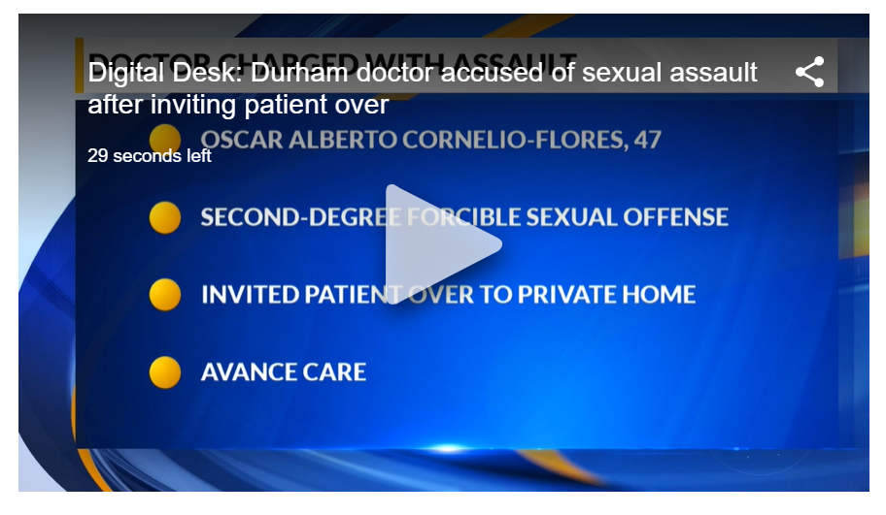
Oscar Alberto Cornelio-Flores
Nov 24, 2020 - Oscar Alberto Cornelio-Flores, 47, was arrested on an indictment that charged him with a second-degree forcible sexual offense, Durham police said.
January 2021
©2021 ICRS

Slide 32
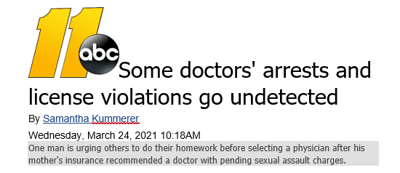
Oscar Alberto Cornelio-Flores
March 24, 2021
Elderly woman’s son contacts media, who breaks story
3 more women have come forward
Additional charges filed
©2021 ICRS

Slide 33
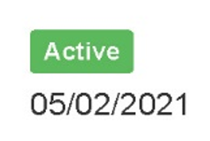
Oscar Alberto Cornelio-Flores
March 25, 2021
Search for Cornelio-Flores – no records
Found under Cornelio, also Flores
NC Board website: ACTIVE, no actions, up to 4 other licenses
©2021 ICRS

Slide 34
Oscar Alberto Cornelio-Flores
Medical school: Peru
Community Preceptor / Adjunct Faculty – Univ of NC
Supervises Physician’s Assistant, Nurse Practitioner
Participates in both US national health plans
Listed address as Durham, NC
Checked Massachusetts, Ohio, Texas licenses
©2021 ICRS

Slide 35
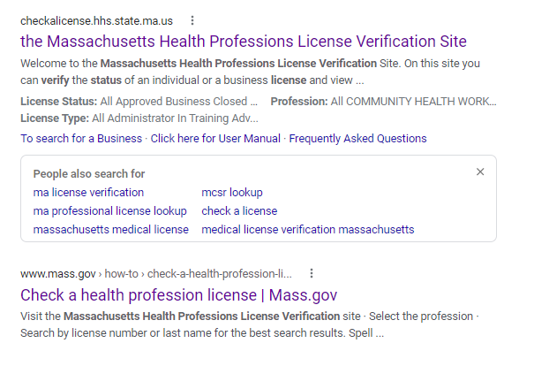
NO MDs or DCs
Are your web resources easy to use?
©2021 ICRS

Slide 36
Oscar Alberto Cornelio-Flores
Massachusetts: Lapsed 2017
Under Cornelio or Flores, NOT Cornelio-Flores
Ohio: Training Certificate Expired 2008
Under Cornelio, NOT Flores or Cornelio-Flores
Texas: Expired 2018, Cancelled 2019 for Non-Payment
Under Cornelio-Flores, NOT Cornelio or Flores
Should these boards be notified? Who should tell them?
©2021 ICRS

Slide 37
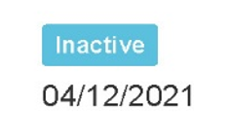
Oscar Alberto Cornelio-Flores
North Carolina – Checked board website again May 2021
Under Cornelio or Flores, NOT Cornelio-Flores
License status inactive
No address
Still supervises PA
Does board have authority over him if not actively licensed?
Is board waiting for resolution of criminal charges?
©2021 ICRS

Slide 38
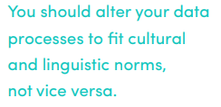
Free Resource
http://www.grcdi.nl/book2.htm
Graham Rhind – based in Germany
Articles, blog posts and white papers re:
Data quality
Name / address data management
©2021 ICRS

Slide 39
Summary
Proper data management enables greater transparency & accountability
Rationale for collecting - Key Performance Indicators / Measures
Entry-friendly (layout, cultural sensitivities) – Metrics
– Which data (if any) should your people be able to update themselves?
Format: length, drop-down fields where practical
– Optimize relational data for Analytics
Study other examples – consider worldwide mobility
People –identification of unique individuals
Privacy considerations
©2021 ICRS
Notes:
Update telephone numbers, fax, email, websites TRACK HISTORY OF ADDRESSES, PHONES, NAMES

Slide 40
Garbage in, garbage out…
OR
Accurate
Relevant
Useful
©2021 ICRS

Slide 41
Credits
Pixabay – illustrations in the public domain
https://pixabay.com
Chiropractic Economics – Issue February 2021, p.
Chiropractic Practice Management, Personal Growth for Chiropractors
Board websites
https://www.gcc-uk.org
https://www.chiropracticboard.org.nz
https://www.chiropracticboard.gov.au
https://www.oregon.gov/obce/Pages/index.aspx
©2021 ICRS

Slide 42
AGENDA
Welcome – Dr Wayne Minter, ICRS Chair
ICRS Overview
Program: It’s All About the Data – Donna M Cohen, ICRS Executive Director
Organizations Registered to Report
Regulatory Members: Canada, New Zealand, UK, Australia
CCE-International – Dr Cynthia Peterson
All Other Updates

